Slide 1

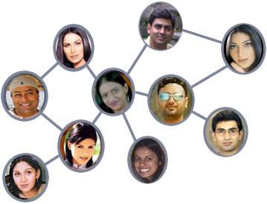

Slide 2
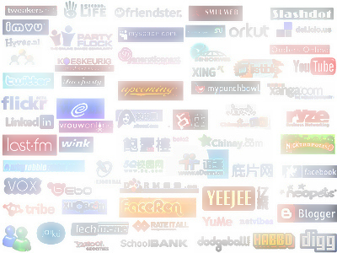
What is Social Networking?
web-based services that allow individuals to construct a public or semi‐public profile within a bounded system, articulate a list of other users with whom they share a connection, and view and traverse their list of connections and those made by others within the system
Most started as blogs or dating sites
“Social Network Site” (newfound way of communicating) vs. “Social Networking” (usually a relationship made among strangers)

Slide 3
What is Social Networking?
gather personal information regarding a user, such as name and interests
sites are crawled by search engines -- really gives the user no privacy at all -- usually involuntarily display their profiles in public search spaces

Slide 4
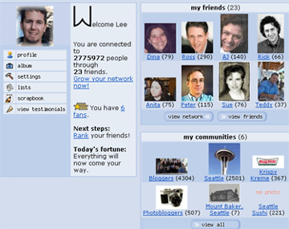
What is Social Networking?
Many flock to specific sites based on ethnicity
Example → “Orkut”
Google started this social site in the US, but it ended up only being popular among Brazilians

Slide 5
History of Social Networking
Boyd and Ellison Article
SixDegrees.com → First recognizable social network in 1997
Combined all of the features dating, blogging and friends sites had to offer

Slide 6
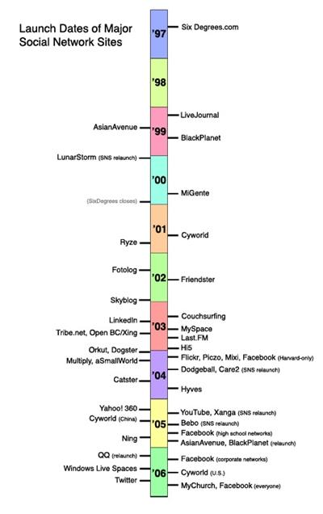
History of Social Networking

Slide 7
History of Social Networking
Match.com was the most popular dating site in 2002
Friendster launched → stated friends of friends would make better companions and have more compatibility than just random selections
Grew to 300,000 before it was even marketed
“4 Degrees of Separation”
FAKE PROFILES

Slide 8
Privacy?
problem for users who fail to take proper measures to limit the amount of personal information to be publically displayed
Study by Ralph Gross and Alessandro Acquisti
looked into the online behavior of more than 4,000 Carnegie Mellon University students who joined popular social networking sites
Wanted to see if they took advantage of privacy options

Slide 9
Privacy?
Could reinvent social security numbers based on some of the information (hometown & DOB)
1.2% adjusted privacy settings to remain unsearchable on Facebook
.06% or 3 profiles total restricted being visible on the school network
Concluded -- “only a minimal percentage of users change the highly permeable privacy preferences”

Slide 10
Positive Social Networking
Most of what we hear negatively about social networks can be prevented
users are given all of the tools they need to provide a secure experience in social networks, but they fail to utilize their resources
Individual error, not a Network error

Slide 11
Positive Social Networking
College students have more access to family, friends, and classmates
Businesses can advertise and promote their products for better economic success
Leads to jobs and better opportunities through sites such as LinkedIn.com
Surveys are most easily taken by people, providing important feedback

Slide 12
Positive Social Networking
New Laws to prevent further problems
EXAMPLE →
* NC - a bill that requires parents and guardians register with a social networking site and verify their ages before their children sign up for an account
- sites that fail to follow the law will be subjected to a fine of $5,000 per day

Slide 13
Conclusion
Employees – be AWARE of your public profiles
take steps to protect ourselves so that we can relax and enjoy what social sites have to offer

